Slide 1
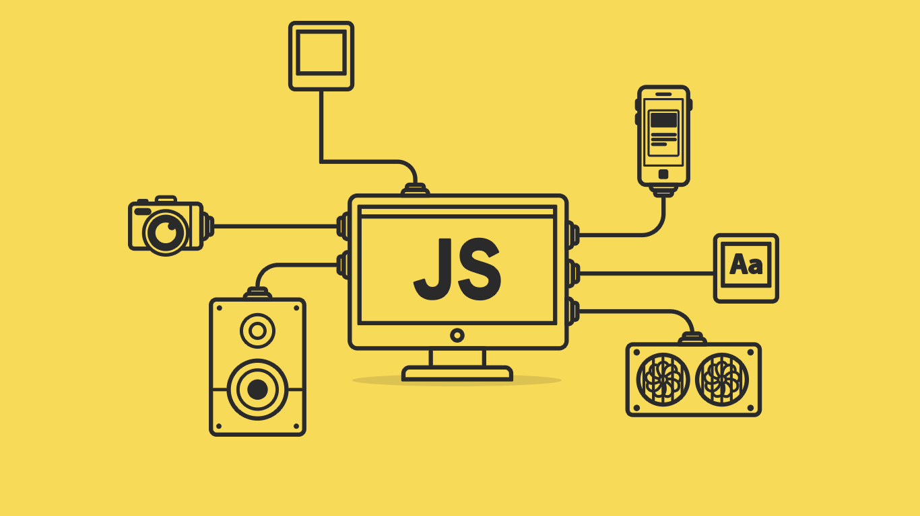

Slide 2
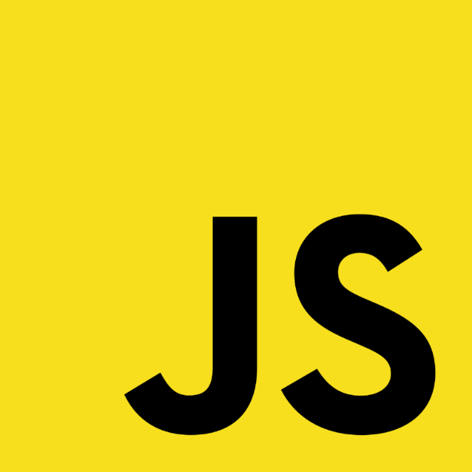
Introduction to JavaScript, Alerts, and Data Types

Slide 3
About today…
Introduction to JavaScript
Using Alerts
Understanding Data Types

Slide 4
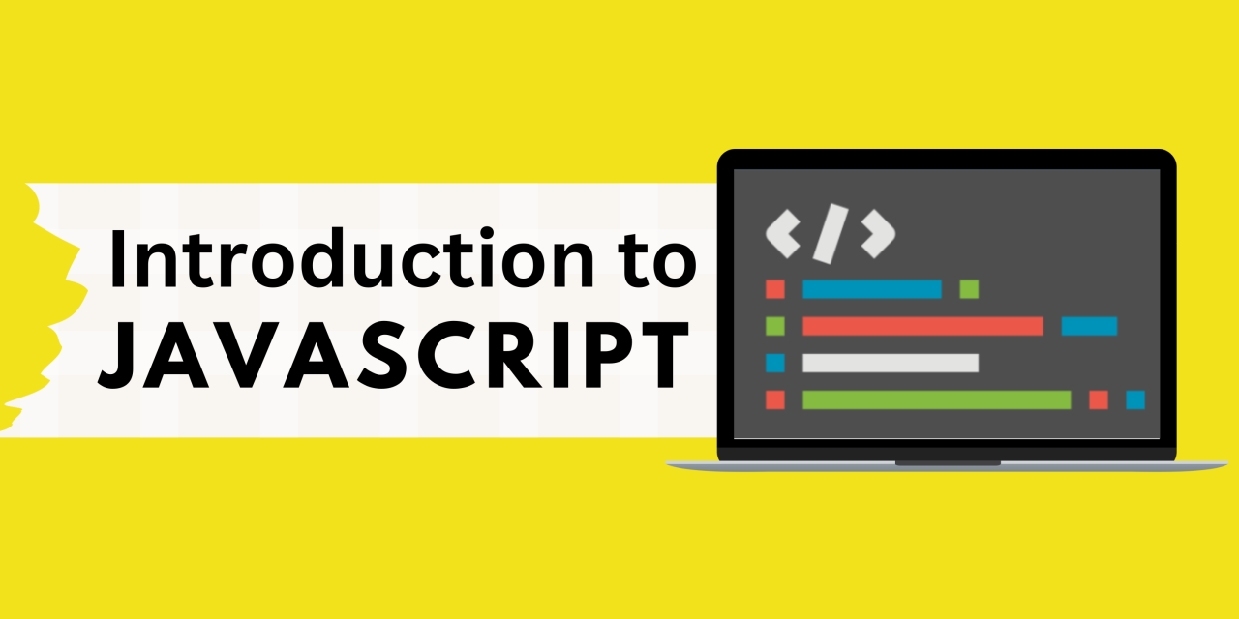

Slide 5

What is JavaScript?
A programming language used to make web pages interactive
Created by Brendan Eich in 1995
Uses:
Enhancing web pages
Building web applications
Game development
etc

Slide 6

Why learn JavaScript?
Popularity: Widely used in web development
Versatility: Works on both client-side and server-side
Community: Large community and extensive resources
?
?
?
?

Slide 7
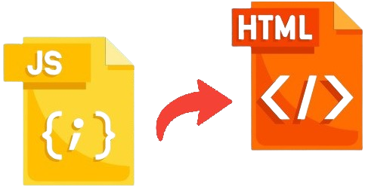
Adding JavaScript to HTML
Inline Script
<script>
alert('Hello, world!');
</script>
External Script
<script src="script.js"></script>

Slide 8
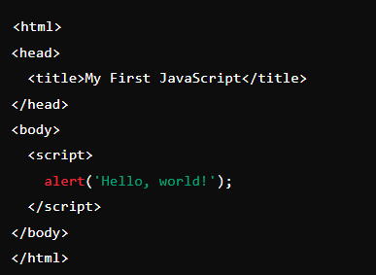
Your first JavaScript Code

Slide 9
What is JavaScript used for primarily in web development?
A) Styling web pages
B) Adding interactivity and dynamic behavior
C) Creating database queries
D) Generating server-side code

Slide 10
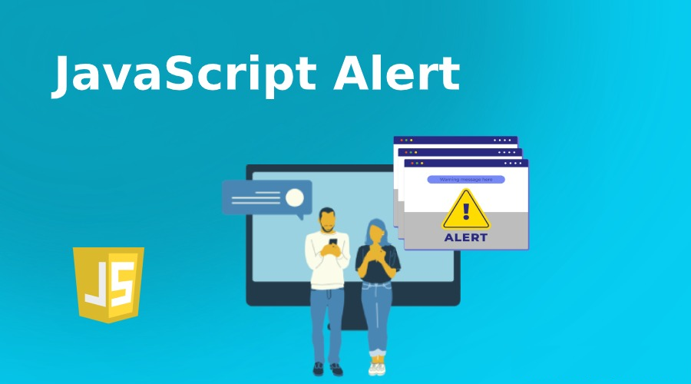
Pop-up messages to the user

Slide 11

Alert Types
Three primary types of alerts :
Alert box
Confirm box
Prompt box

Slide 12
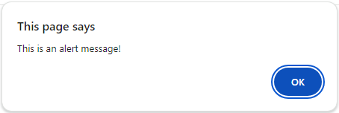

Alert Box
Used to display a simple message to the user
Has an "OK" button, and the user must click "OK" to proceed

Slide 13
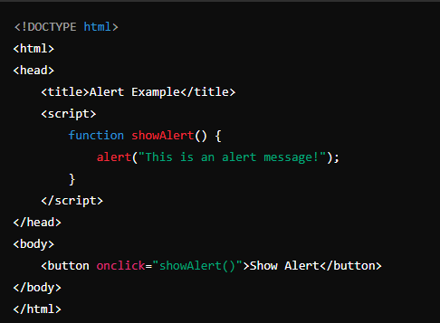
Example

Slide 14
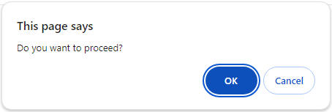

Confirm Box
Used to ask the user for confirmation
Has two buttons: "OK" and "Cancel"
Returns true if the user clicks "OK" and false if the user clicks "Cancel

Slide 15
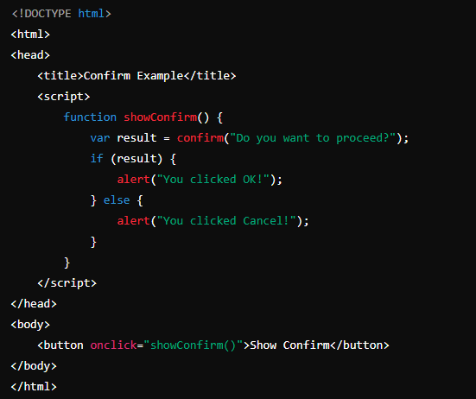
Example

Slide 16
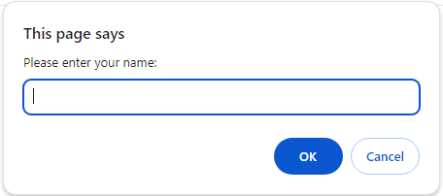

Prompt Box
Used to ask the user for input
Has two buttons: "OK" and "Cancel"
returns the input value if the user clicks "OK" and null if the user clicks "Cancel"

Slide 17
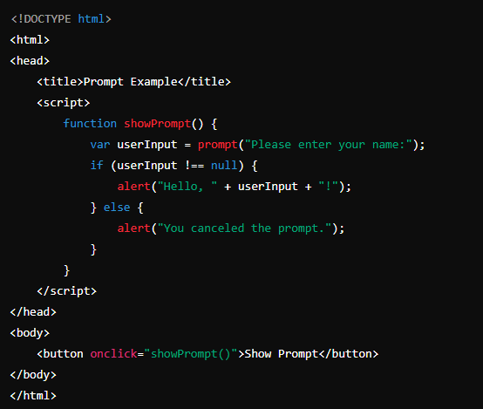
Example

Slide 18
Which statement is correct about alerts in JavaScript?
A) Alerts are used to display messages in the console.
B) Alerts are used to display messages in a pop-up dialog box.
C) Alerts are used to execute code asynchronously.
D) Alerts are used to define variables in JavaScript.

Slide 19
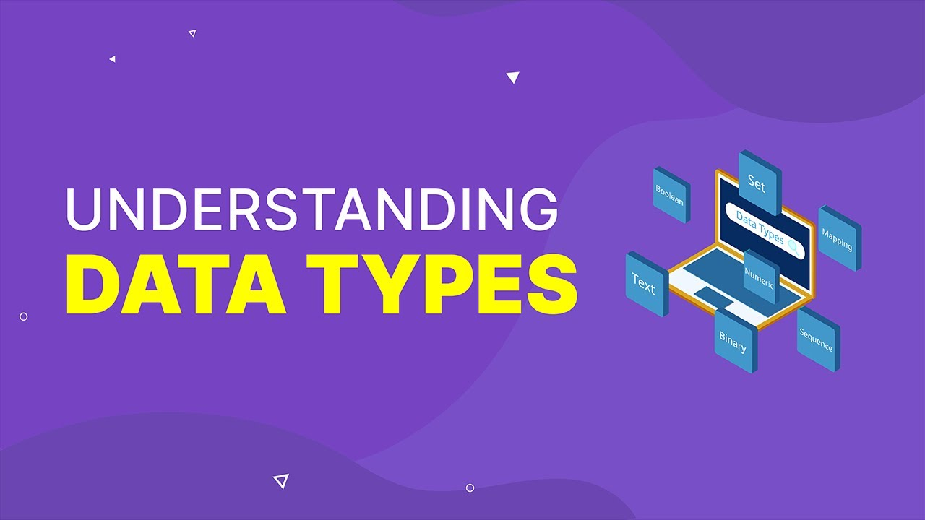

Slide 20
JavaScript Data Types
Primitive Types
String: "Hello"
Number: 42
Boolean: true or false
Undefined
Null
Non-primitive Types
Object: { key: 'value' }
Array: [1, 2, 3]
they reference data instead of storing
they directly store the value itself

Slide 21
Strings
A sequence of characters
Examples
'Hello'
"World"

Slide 22
Numbers
Numeric data
Examples
123
3.14

Slide 23
Booleans
Represents logical values
Examples
true
false

Slide 24

Undefined
A variable that has been declared but not assigned a value
Example

Slide 25

Null
A variable explicitly assigned with no value
Example

Slide 26

Objects
Collection of properties
Example

Slide 27

Array
Ordered list of values
Example

Slide 28
Which data type represents a sequence of characters in JavaScript?
Number
Boolean
String
Array

Slide 29
What is the value of the expression 5 + "5“ in JavaScript?
10
55
‘55’
Error

Slide 30
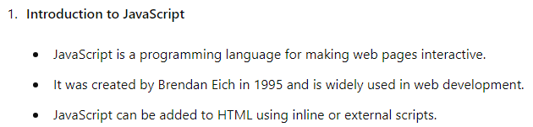
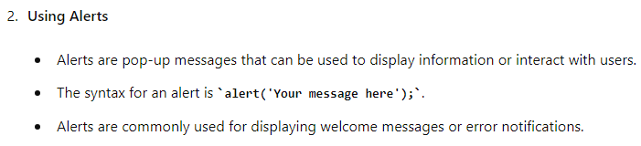
RECAP

Slide 31
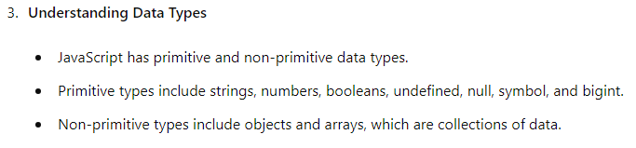
RECAP

Slide 32
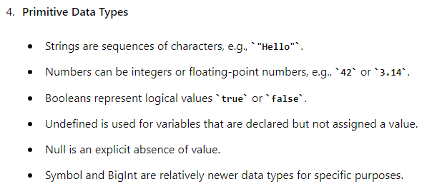
RECAP

Slide 33
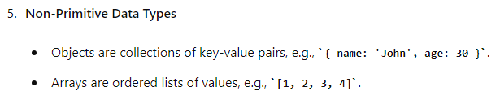
RECAP

Slide 34
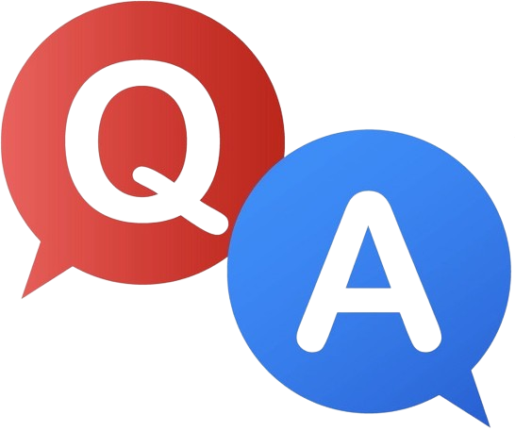

Slide 35
Home Work
Practice
Writing 3 alerts
Using different data types
NEXT
JavaScript variables and naming conventions

